Slide 1

Data Envelopment Analysis (DEA) for Chinese Manufacturing Companies
By: Daniel Hom and Moiz Sadiq Awan

Slide 2
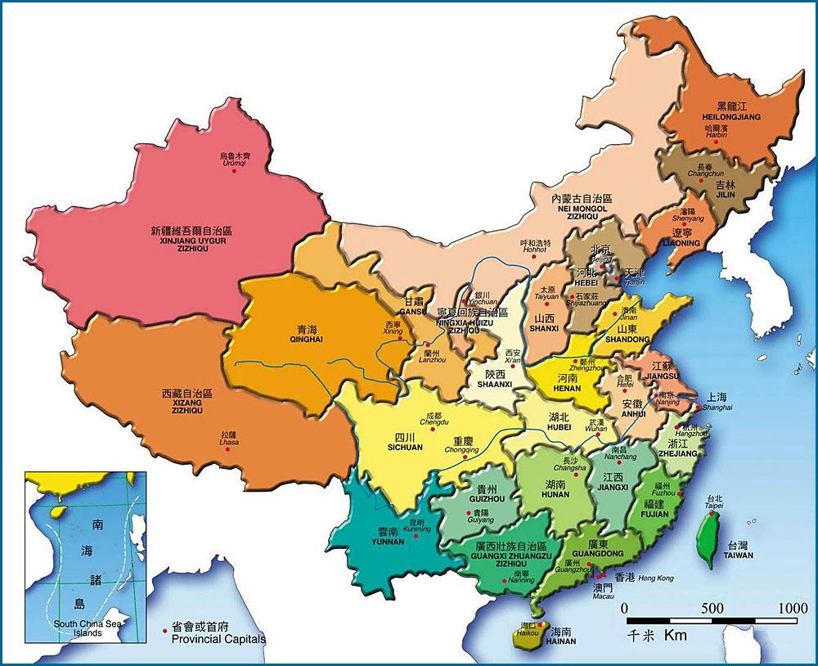
Business Problem:
A consultancy firm advising the Chinese government on the procurement of manufactured goods, is developing a scalable mechanism for measuring the efficiency of factories across Chinese provinces.
The consultancy firm would like to utilize this mechanism for identifying which factories were the least efficient, and whether efficiency for those factories improved over time.
Procurement contracts with the Chinese government are renewed every 5 years. At the end of every 5 years, the Chinese government assesses whether to renew its procurement contracts.
The Chinese government intends to utilize measurements on efficiency as a factor in its general criteria for assessing whether to renew its procurement contracts with factories.

Slide 3
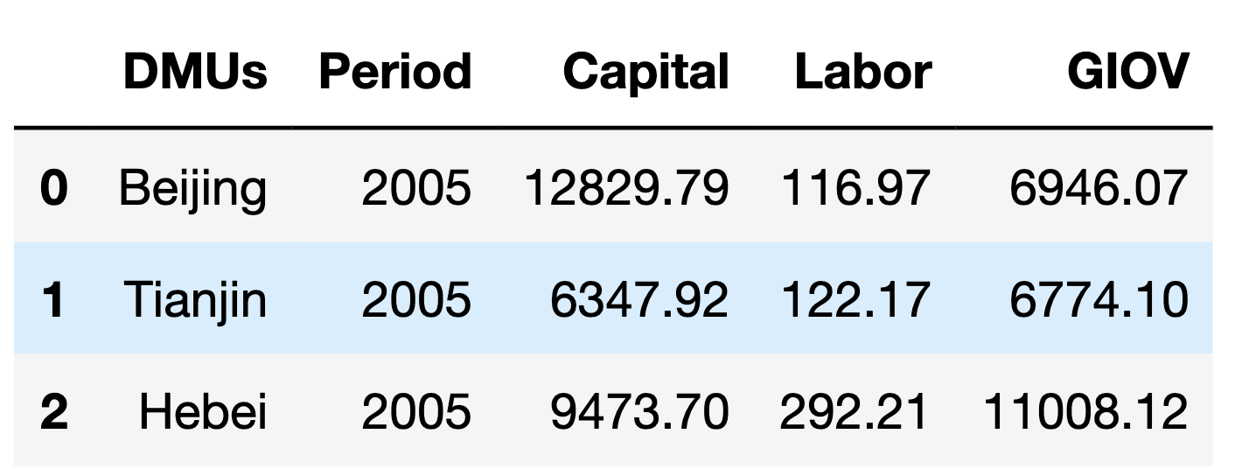
Data Structure and Collection::
From fiscal years 2005-2009, data was collected on factories across 31 Chinese provinces.
The final data set consisted of approximately 155 data entries.
The data collected pertained to the following variables:
DMUs: The province where a particular factory is located.
Period: Fiscal Year (2005-2009)
Labor: Annual average employed persons (in 10,000 persons)
Capital: Total factory assets (in 100 million RMB)
GIOV: Gross industrial output value (in 100 million RMB)
Once data on these variables had been collected, it was then inputted into Python, in order to scale utilization of DEA in measuring the overall efficiency for each factory in a particular year.

Slide 4

Introduction and Application of Decision Envelopment Analysis:

Slide 5

Data Envelopment Analysis:
Multi-Attribute Decision Making (MADM): Refers to problems with n alternatives that are assessed against m criteria. The results from MADM are used to score or rank alternatives.
During the process of making business decisions, scoring is a prominent heuristic for evaluating alternatives.
Data Envelopment Analysis (DEA): A specific subgroup of MADM that is used for scoring business efficiency, based upon the inputs and outputs for that business.
Applications of DEA have a lot of value in the manufacturing sector, where it is used to assess the efficiency of factories.

Slide 6
Why DEA for Assessing Factory Efficiency?
DEA is viewed as a fair and impartial mechanism for evaluating factory efficiency.
DEA will be easy to interpret and explain to Chinese officials when making critical business decisions.
The structure of the data collected on factory efficiency is conducive to being inputted into a DEA model.
Deployment of a DEA model can easily be scaled up to provide the efficiency scores from 2005-2009, for each of the 31 factories from within the data set.

Slide 7
Selecting the Inputs and Outputs:
Inputs and Outputs
To create a scalable DEA model that scores the efficiency for each factory from within the data set, it was first important to upload the data onto a Jupyter Notebook on Python in preparation for analysis.
After the data was uploaded onto Python, the inputs and outputs for the DEA were selected as follows:
Inputs (in green):
Capital (in 100 million RMB)
Labor (in 10,000 persons)
Outputs (in blue):
Gross Industrial Output Value (GIOV) (in 100 million RMB)
Capital and Labor were selected as the inputs because they were the resources used to generate the output.
GIOV was selected as the output since it refers to the amount produced by each factory.
Once the inputs and outputs were selected, a DEA model that generated the efficiency scores for each factory from 2005-2009 was constructed.
Inputs
Outputs

Slide 8

Construction of the DEA Model onto Python:
To construct a linear model for DEA, it was first important to import Pyomo, which is a linear optimization package for Python into Jupyter Notebooks, utilizing this package is critical for calculation of the efficiency scores.
The values for the inputs and outputs from within the data set were then inputted into a list. The information from these lists was then used to calculate separate weighted input and output scores. The calculated output score divided by the input score constitutes the efficiency scores in DEA.
Constraints: From within the linear optimization program, there were two constraints which were as follows:
Output_scores <= Input Scores (A factory can only produce outputs using the resources that it has available)
Input Scores = 1 (In DEA, there can be no efficiency score > 1)

Slide 9

Construction of the DEA Model onto Python (Continued):
Decision Variables: In the linear programming model, the decision variables were the weights used for calculating the weighted input and output scores necessary for computing the overall efficiency score for each factory.
Objective: Maximize the calculation of the weighted output scores to yield a solution for the linear program. The greater the output score, the higher the overall efficiency score as calculated by the output scores divided by the input scores (calculations were structured to keep the program linear).
Once the Constraints, Decision Variables, and Objectives from within the linear programming model were established, a nested for loop was used to calculate the efficiency scores for each of the 31 factories from within the data set from between 2005-2009.

Slide 10
The Entire Python Code Used to Construct the DEA model
efficiencies = []
years = [2005, 2006, 2007, 2008, 2009]
for year in years:
#df = df[df['Period'] == year]
df_input = df[['Capital','Labor']][df['Period']==year]
df_output = df[['GIOV']][df['Period']==year]
inputs = df_input.values.tolist()
outputs = df_output.values.tolist()
input_len = len(inputs[0])
output_len = len(outputs[0])
for cmp in range(len(inputs)):
#declare a concrete model
model = ConcreteModel()
#dvs
model.x = Var(range(input_len),domain = NonNegativeReals)
model.y = Var(range(output_len),domain = NonNegativeReals)
#Constraint 1: outputscore <= inputscore
model.Constraint1 = ConstraintList()
for i in range(len(inputs)):
output_score = sum(outputs[i][j]*model.y[j] for j in range(output_len))
input_score = sum(inputs[i][k]*model.x[k] for k in range(input_len))
model.Constraint1.add(expr = output_score<=input_score)
#constraint 2 inputscore = 1
model.Constraint2 = Constraint(expr = sum(inputs[cmp][i]*model.x[i] for i in range(input_len)) == 1)
#objective
model.Objective = Objective(expr = sum(outputs[cmp][i]*model.y[i] for i in range(output_len)), sense = maximize)
opt = SolverFactory('glpk')
results = opt.solve(model, tee = False)
#append to efficiencies list
efficiencies.append(round(model.Objective(),2))
#print the objective
#print("Efficiency for",df['DMUs'].iloc[cmp],"in year",year,"=", round(model.Objective(),2))
Notes:
Note: This is just a reference slide and will be hidden during the presentation to avoid any confusion by non-technical members of the audience.

Slide 11
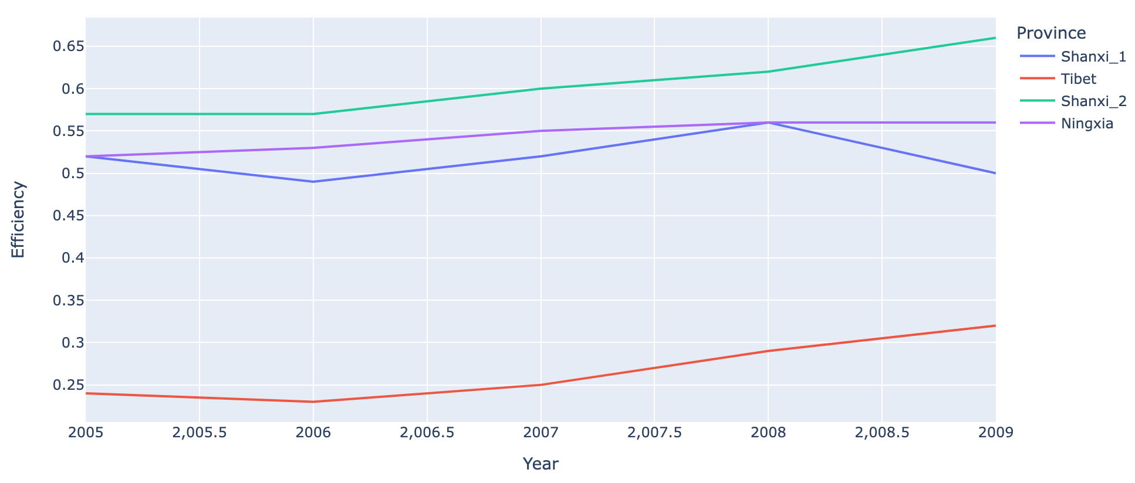
Relative Efficiency Trend for Worst Performing Provinces:
The least efficient factories were very inefficient.
The least efficient factories were located in Ningxia, Shanxi_1, Shanxi_2, and Tibet provinces.
The least efficient factories were in central-western China, which is less developed.
Other than in Shanxi_1, efficiency seems to be improving over time.

Slide 12
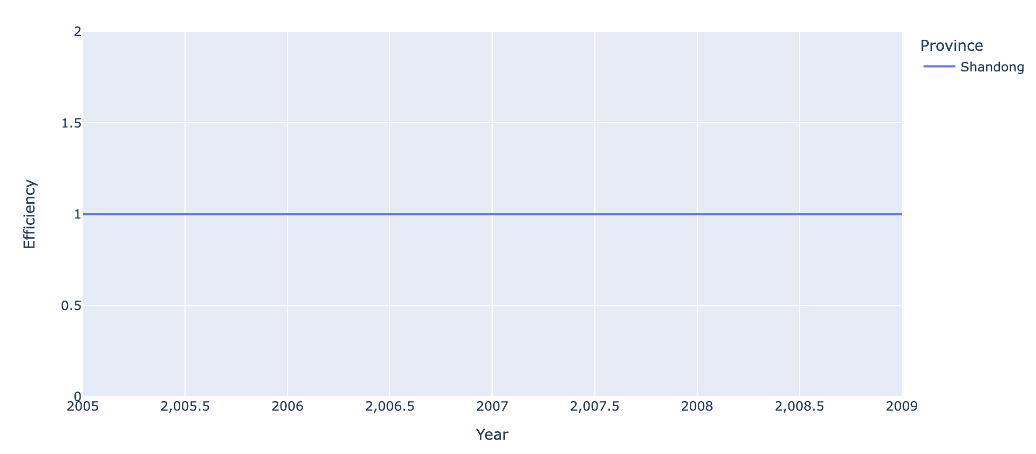
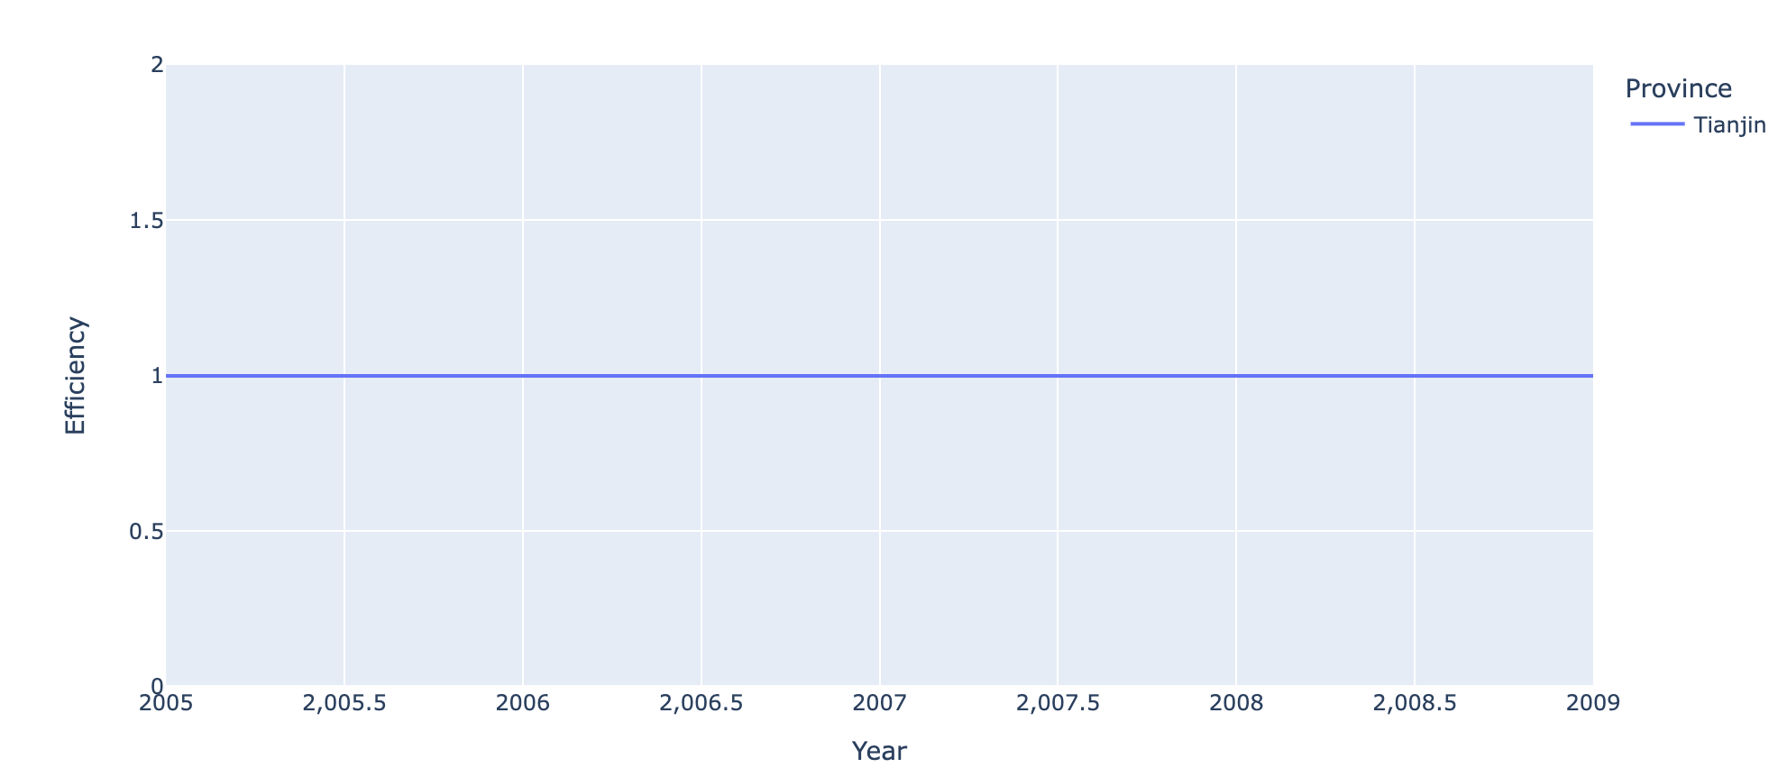
Relative Efficiency Trend for Best Performing Provinces:
Only 2 factories had efficiency scores consistently at 1 from 2005-2009.
These factories were located in Tianjin and Shandong provinces.
The more efficient factories seem to be located in eastern China, which is more developed.
There may be a strong link between efficiency and economic development.

Slide 13

Exploratory Analysis and Regression Modeling:

Slide 14
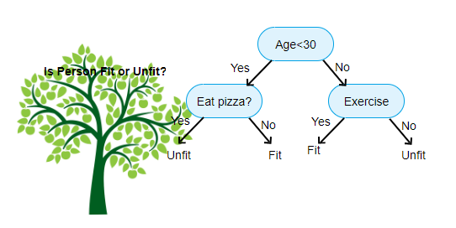
Introduction to Algorithmic Learners:
Algorithmic Learners: Are machine learning models that use computer algorithms to predict outcomes.
Classification and Regression Trees (CART): CART is an algorithmic learner that successively splits the feature space (variables) of the data based upon specified criteria to make predictions.
Random Forests & Boosting: Are algorithmic learning models that run multiple CART models, then aggregate the results from those CART models to yield more accurate predictions on the data.

Slide 15
Formal Definitions on Boosting and Bagging:
Bootstrap Aggregation (Bagging): Occurs whenever a training data set is drawn with replacement (bootstrapping) from an original data set n times.
Each time, the sampled bootstrapped data is inputted into an individual CART model n times, with each individual model having the same weights.
CART models in which bagging is deployed are typically referred to as Random Forests.
Boosting: Occurs when the training set remains constant, while the weights for each sample n are adjusted in accordance with the classification results from the previous CART model (n-1).
With boosting, the weights of the samples are continuously adjusted according to the error rate.
Notes:
Note: This slide is hidden as not to confuse the audience with complicated Machine Learning concepts. Instead, this slide is per the audience’s reference.

Slide 16
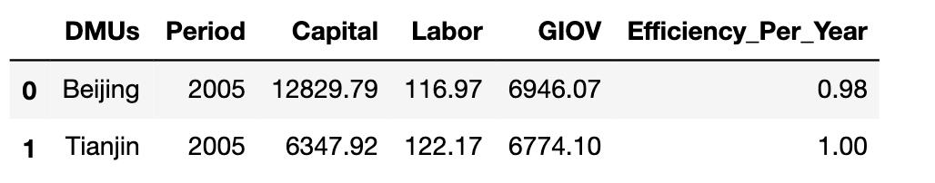
ML Applications for DEA:
Upon recording the efficiency scores from 2005-2009 for each factory, it is important to determine which features were most impactful in determining efficiency. Knowing this information is useful in making future predictions on factory efficiency when the size of the data and computational requirements increase exponentially in the future.
In Python, a Random Forest and Boosted machine learning model were constructed, in which Capital, Labor, and GIOV were the independent variables and Efficiciency_Per_Year was the dependent variable.
Data
Once the machine learning models were constructed, the results were evaluated.
Independent Variables
Dependent Variable

Slide 17
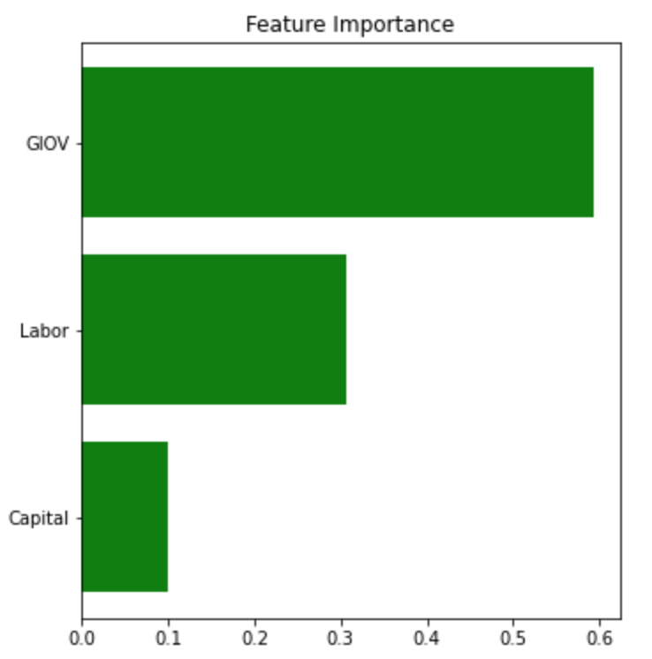
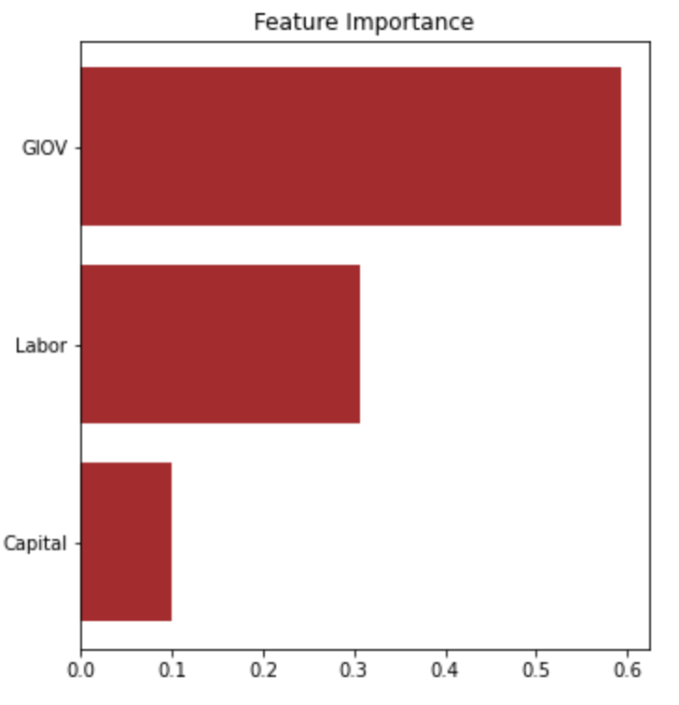
Results::
Random Forest Model
Boosted Model
The R-squared is a common measure used to evaluate the goodness of fit for machine learning models. The larger R-squared is, the better the fit for that ML model.
The R-Squared for the Random Forest and Boosted Model were as follows:
Random Forest: R-squared = 0.758
Boosting: R-squared = 0.718
Because the R-squared for the Random Forest model is larger, it is recommended that this model be deployed when predicting for factory efficiency.
Note: There are not a lot of features in the data set; however, GIOV is the most important feature in determining factory efficiency.

Slide 18

Conclusions and Limitations:

Slide 19
Assumptions and Limitations of DEA:
• It was not necessary to rank anything in the analysis, as DEA is ineffective as a criteria for benchmarks and rankings.
• Evaluating factory efficiency was the only objective in the linear programming problem. DEA is not as effective for solving multi-objective linear programming problems.
•There was a sufficient amount of information that was initially given. DEA requires a lot of information on business inputs and outputs in providing an effective measure for business efficiency.
•The process of selecting the inputs and outputs necessary for calculating the efficiency scores was objective and not arbitrary.

Slide 20

Conclusions and Recommendations:
Using DEA to calculate the efficiency scores can be a powerful tool for establishing objective criteria necessary for deciding whether or not to renew a procurement contract with a given factory.
More information is needed for improving the comprehensiveness of DEA in scoring for factory efficiency.
When utilizing DEA to calculate the efficiency scores, GIOV (output) is the most important determinant of factory efficiency. There also appears to be a strong relationship between economic development and efficiency.
As the factories in Tianjin and Shandong provinces were consistent in their efficiency, it is recommended that the Chinese government renew its procurement contracts with the factories in those provinces.
There are other considerations besides efficiency. Therefore, the efficiency scores should be just part of a holistic criteria necessary for deciding whether to renew a procurement contract.

Slide 21

Thanks for listening to this presentation!

Slide 22
Submission Details:
Group Members:
Daniel Hom
Moiz Sadiq Awan
Project Documentation:
EconomyLong.xlsx (The data set used for the DEA model in this analysis)
Microsoft Excel File for construction of basic DEA model
Final Scaled DEA model in Python ipynb file
PowerPoint Business Presentation Slides
Roles:
Construction of basic DEA model in Excel (Moiz Sadiq Awan)
Construction of DEA model in Python (Moiz Sadiq Awan)
Creation and Edits of the Slides (Daniel Hom)
Machine Learning and Data Visualization Analysis (Moiz Sadiq Awan & Daniel Hom)
Debugging, Editing, and Formatting of DEA models in Python and Excel (Daniel Hom)

Slide 23
Images Cited
You, Tracy, and Raemin Zhang. “40 Beautiful Places to Visit in China.” CNN, Cable News Network, 12 July 2017, https://www.cnn.com/travel/article/china-beautiful-places/index.html.
“China Provincial Map.” China Provincial Map, Map of China Provinces, China Maps, http://worldtourguidetravels.com/china-maps/china-provincial-map.html.
Schiller, Jakob. “China's Stunning Terraced Rice Paddies Woke up like This.” Wired, Conde Nast, 15 July 2015, https://www.wired.com/2015/07/thierry-bornier-rice-paddies/.
Sarmah, Bhaskarjit. “Introduction to Data Envelopment Analysis in R.” Medium, Analytics Vidhya, 15 Sept. 2018, https://medium.com/analytics-vidhya/introduction-to-data-envelopment-analysis-in-r-773745549d6a.
Macrovector. “House Construction Cartoon Vector Image on VectorStock.” VectorStock, 28 Jan. 2016, https://www.vectorstock.com/royalty-free-vector/house-construction-cartoon-vector-7406182.
“Animated House #1752456 (License: Personal Use).” Animate Houses - Clip Art Library, http://clipart-library.com/clipart/8TzrEk7Rc.htm.

Slide 24
Images Cited
“Beautiful Bamboo Forests [40 Pics]: Fast Growing Plants, Bamboo Forest, Growing Plants.” Pinterest, https://www.pinterest.com/pin/106327241175339324/.
Sharma, Mathanraj. “Fundamentals of Classification and Regression Trees (CART).” Medium, Medium, 22 Aug. 2019, https://mathanrajsharma.medium.com/fundamentals-of-classification-and-regression-trees-cart-e9af0b152503.
“Chinese Garden Design: Tips for Creating Chinese Gardens.” Diverse Garden, 4 Apr. 2018, https://www.diversegarden.com/special/spaces/creating-chinese-gardens.htm.
Nguyen, Van. “3 Biggest Limitations of Magento Related Products Need Fixing.” BSS Commerce - Full Services e-Commerce Solution Provider, 14 Sept. 2021, https://bsscommerce.com/blog/3-biggest-limitations-of-related-product-in-magento-2/.
“Hainan.” Wikipedia, Wikimedia Foundation, 14 Dec. 2021, https://en.wikipedia.org/wiki/Hainan#/media/File:%E4%B8%89%E4%BA%9A%E5%A4%A7%E5%B0%8F%E6%B4%9E%E5%A4%A9%E6%99%AF%E5%8C%BA%E9%A3%8E%E5%85%89_-_panoramio_(20).jpg.

Slide 25
Works Cited
Vicente Coll-Serrano, Vicente Bolos. “Economylong: Data: Wang and Lan (2011). in Dear: Conventional and Fuzzy Data Envelopment Analysis.” EconomyLong: Data: Wang and Lan (2011). in DeaR: Conventional and Fuzzy Data Envelopment Analysis, 16 Nov. 2021, https://rdrr.io/cran/deaR/man/EconomyLong.html.
Hwang, Shiuh-Nan, et al. SpringerLink. Vol. 239, Springer Science+Business Media LLC, 2016.
Oh, Seog-Chan, and Alfred J. Hildreth. Analytics for Smart Energy Management Manufacturing: Tools and Applications for Sustainable Manufacturing. Springer, 2016.
Zhu, Joe. Data Envelopment Analysis: A Handbook of Empirical Studies and Applications. Vol. 238, SPRINGER, 2016.
Handbook on Data Envelopment Analysis, edited by William W. Cooper, et al., Springer, 2011. ProQuest Ebook Central, https://ebookcentral.proquest.com/lib/wisc/detail.action?docID=798551.
Notes:
Good reference for future GB-730 students who undertake DEA modeling for this assignment next year.

